Slide 1
GISt Making sense of earthquake data and models
Yuhong Wang

Slide 2
Problem
Earthquakes, the only natural disaster that is almost impossible to predict
Models are complicated to use and data is messy

Slide 3
Theories/Questions
Are earthquakes correlated with moon phase and time of day?
Are there more earthquakes in recent years?
Does crust deformation lead to earthquake activity?
Has our emergency response improved over time?

Slide 4
Data Sources
USGS API for earthquakes 1900-present worldwide – geojson
NOAA for major earthquakes 2000 BC-present worldwide – tsv
GPS strain tensor data from Global Quake Model – tsv
Astronomical calculations on moon phases and sunrise and sunset times – computed
Variety/computation, moderate volume, some velocity

Slide 5
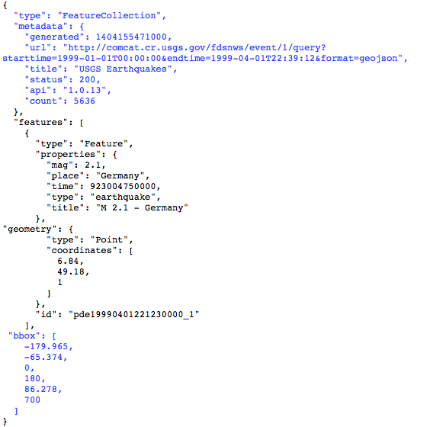

Slide 6







Pipeline Summary
Queries/Views
JSON to TSV
+ Computation In Streaming
HTTP Endpoint
Analytic Queries

Slide 7
Findings
Increase in earthquake reporting over the decades, more small magnitudes
Strain is very correlated with magnitude but not when strain is highest
Damage over time has varied (spikes, more property damage, fewer deaths) but given population has increased, this is good
Weak relationship with moon phase but some correlation with time of day (sunrise)

Slide 8
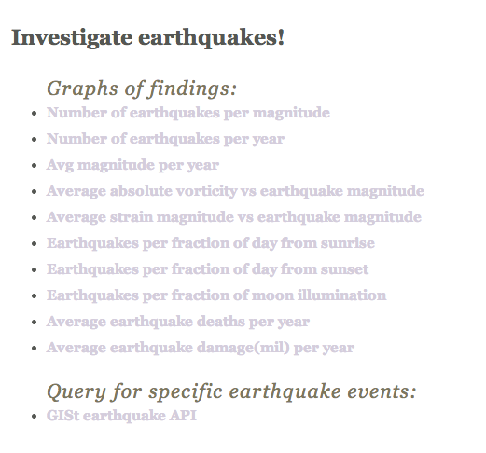

Slide 9
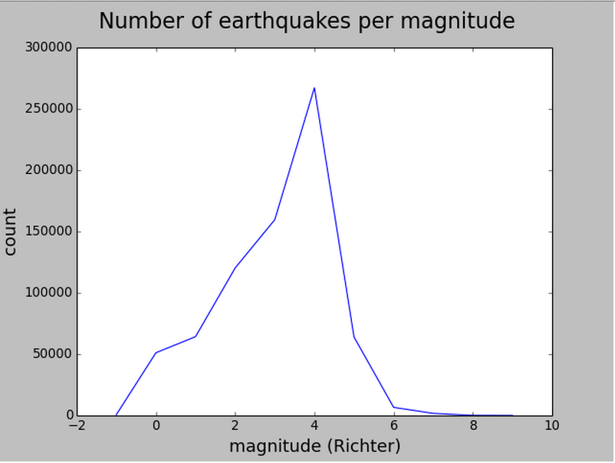

Slide 10
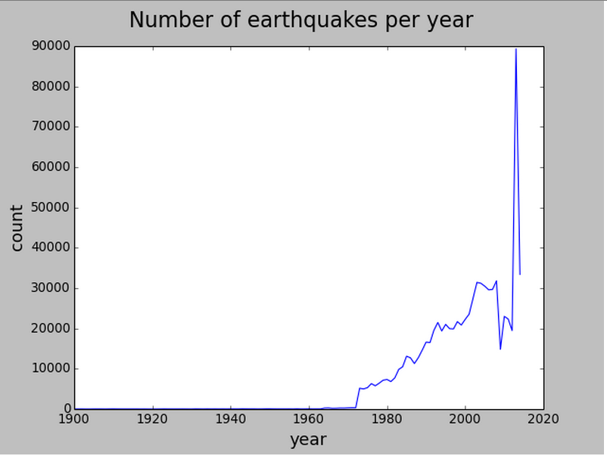

Slide 11
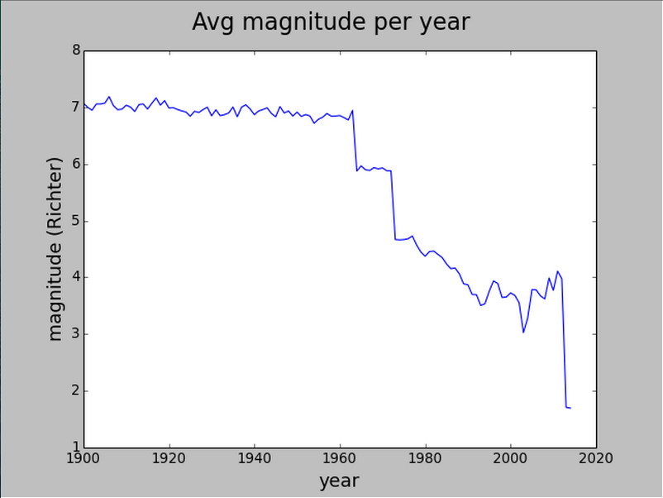

Slide 12
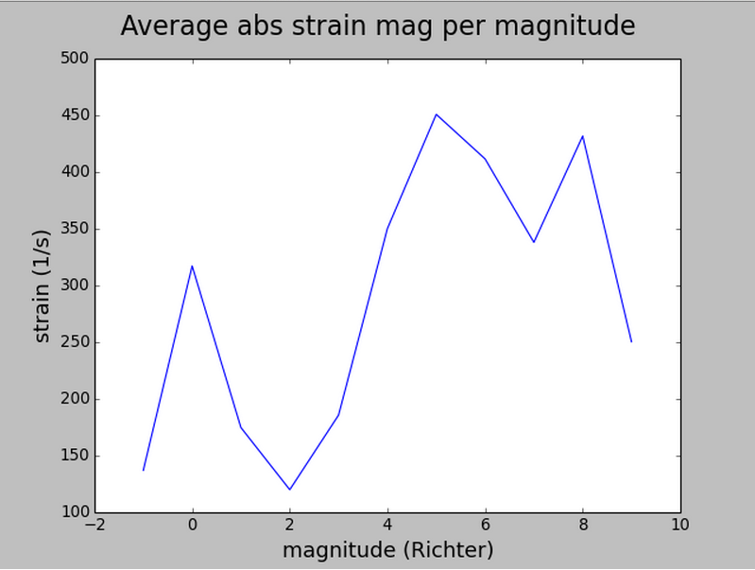

Slide 13
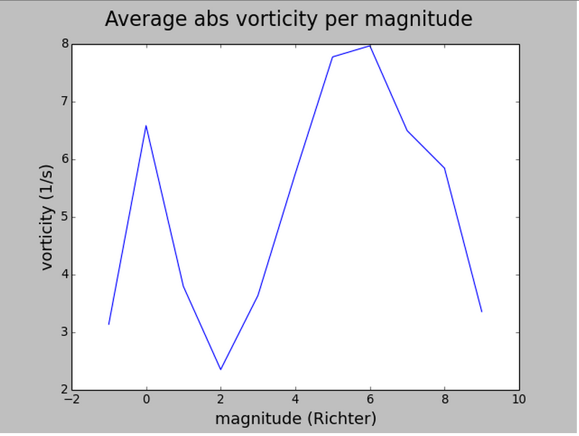

Slide 14
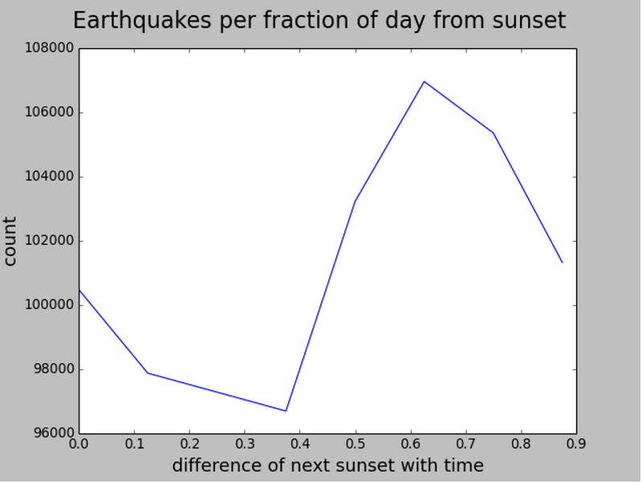

Slide 15
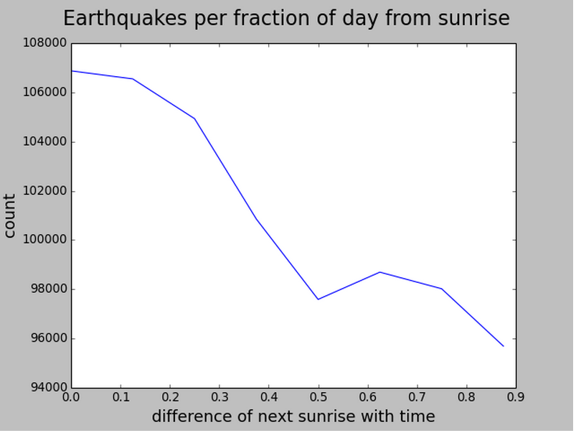

Slide 16
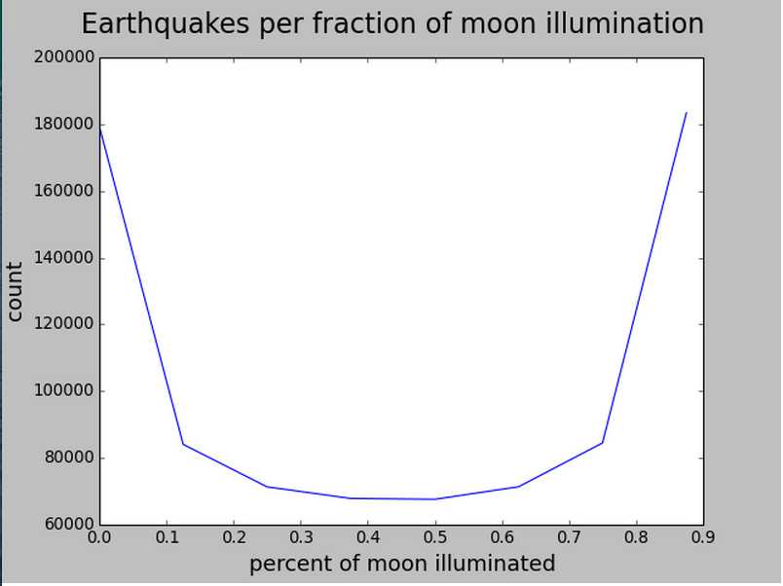

Slide 17
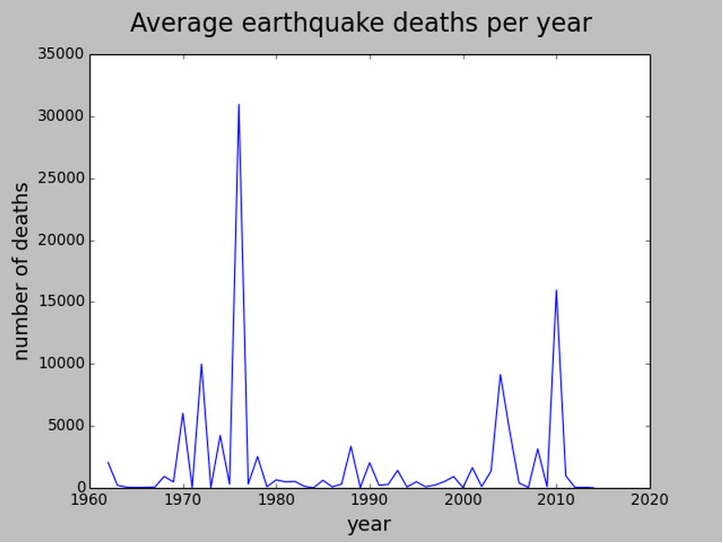

Slide 18
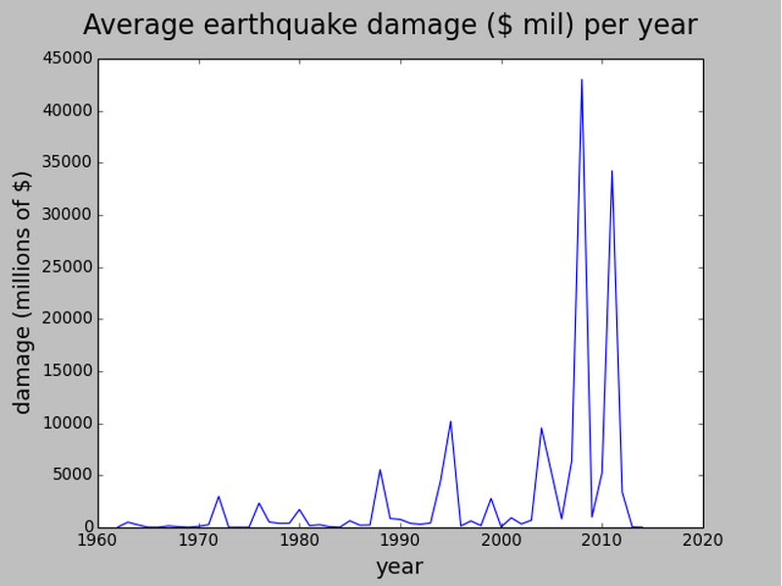

Slide 19
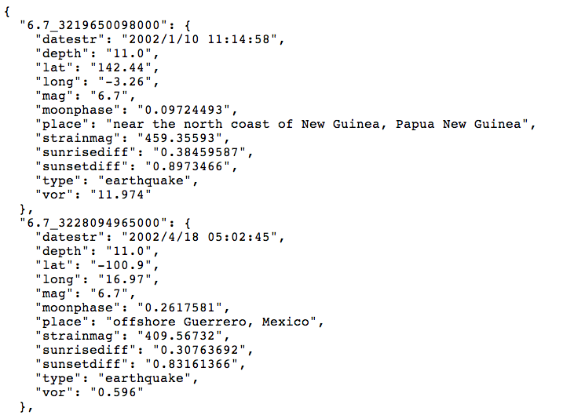

Slide 20
“Interesting” Lessons
Polar earthquakes
Sparsity of data
Choose delimiters wisely
Cloudera Manager doesn’t have a “forgot password” reset

Slide 21
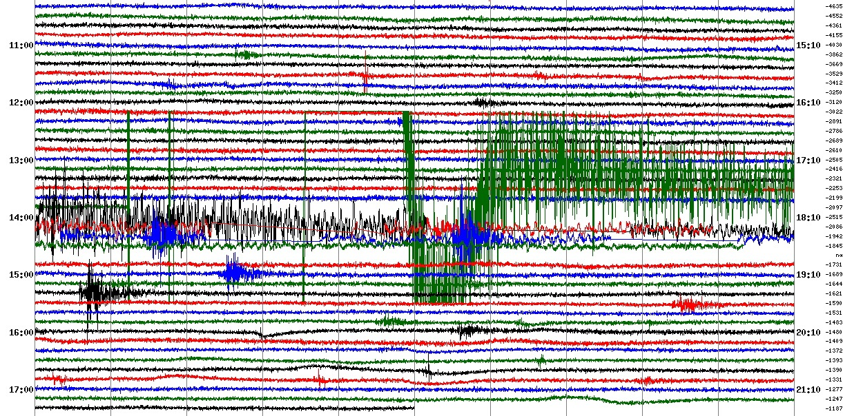
Enhancements
Combine city/population to build risk model
Automatic forecasting abilities
For the ambitious: summarize seismograph data in a better format

Slide 22



About Yuhong
Signal Processing (ML precursor) + Hardware Design

Slide 23


Slide 24
Additional Slides

Slide 25
Data Pipeline
HTTP Endpoint
HBase API
happybase
Queries/Views
Local Machine:
Sequential API requests + updates
HDFS
JSON to TSV
+ Computation
In Streaming
Hive Table
Analytic Queries

Slide 26
Strain and Vorticity
Measurement of overall strain summarized into a magnitude of the tensor
Magnitude of strain is taken to be the norm of the exx,exy,eyy directionals of the tensor
Vorticity can be thought of as the rotational tendency of the area, although there may be zero deformation in that cell
Many points, however, in the middle of plates have neither so the values are close to zero

Slide 27
Data processing specs
JSON to TSV
Computing sunrise/sunset
Dictionary lookup
Hive queries
HBase queries

